Slide 1
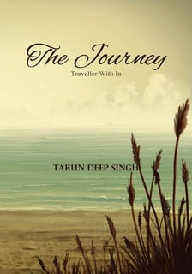
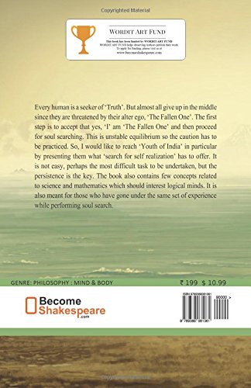
The Journey Traveler With In By Tarun Deep Singh
To join our WhatsApp group, open the link given below on phone:
https://chat.whatsapp.com/Gta8r5Mj2Qs5LbsUIAfaEa

Slide 2
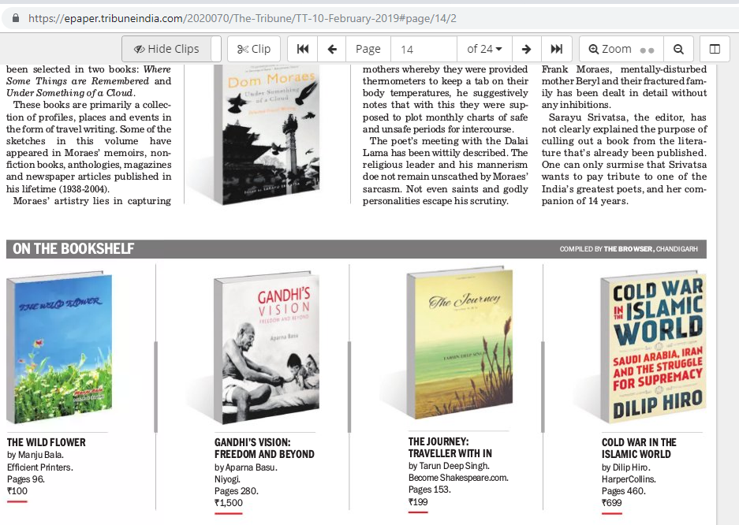
The Journey – Featured in Tribune on 10-Feb-2019

Slide 3
Glimpse of Reviews By Leading Bloggers
KBR: 5/5
Tarun Deep Singh is one of the rarest writers in India who loves to plunge into the depth of his subjects.
The book is a treasure; the more you get into it and read it, the more you will explore yourself.
Unshut Blog: 4.8/5
I thought this book to be a self help philosophical book, but the content is beyond just philosophy.
You’ve to sink in deep to understand each concept.
This self remedy is full of knowledge, correct philosophy which is supported with facts and concrete ideas.
For me, this was personally motivating and positive.
Sanchari Blogs: 5/5
Spiritually uplifting, takes the readers on a philosophical ride with thought-provoking ideas that makes us look back at life and then into our inner self.
The great lines quoted from Gurbaani, Guru Granth Sahib Ji, Bhagavad Gita and the Dohas of Kabir are very inspiring.
Live It Queen Size: 4.5/5
It is spiritually uplifting and enough to make you introspect and ponder on the different aspects of life.
A journey to enlightenment, makes you introspect and promotes healing and self-growth.
Vandana Choudhary: 5/5
This book will surely help readers in becoming a better person and most importantly understanding their inner world.
I liked the writing style of author and would highly recommend this book to everyone.
Solitude And Books: 4.5/5
The Author has done vast research and have poured extreme hard work in compiling his best thoughts in this book.
These kind of books need an open mind.
SMA Reviews: 5/5
Self help book but it is beyond the self help it’s all about the self realization and about to analyze the inner soul.
Quotes form the religious book Gita, Guru Nanak and Gautam Buddha are also the points of attractions for the book.
A must read very worthy and One of the best of my self help books.
Soulful Quotes: 4/5
The concept of book is very relatable and anyone can enjoy reading it.
The book is perfect pick for anyone who wants to know the purpose of his/her life.
Booxoul: 4/5
The book has a very unique concept to it, which makes it more fun to read.
Each chapter is unique unto itself and gives fodder for thought.
Ultimate Reviewer: 5/5
The author has flourished this book inside out with his years of wisdom.
it is truly a journey within ourselves.

Slide 4
Blurb
Every human is a seeker of ‘Truth’. But almost all give up in the middle since they are threatened by their alter ego, ‘The Fallen One’. The first step is to accept that yes, ‘I’ am ‘The Fallen One’ and then proceed for soul searching. This is unstable equilibrium so the caution has to be practiced. So, I would like to reach ‘Youth of India’ in particular by presenting them what ‘search for self realization’ has to offer. It is not easy, perhaps the most difficult task to be undertaken, but the persistence is the key. The book also contains few concepts related to science and mathematics which should interest logical minds. It is also meant for those who have gone under the same set of experience while performing soul search.

Slide 5
Chapter 1 – The Fallen One
In this chapter the main focus is on the very entity responsible for challenging virtues in an individual. This is ‘something’ which is not separable for any of us. It is just a myth that we consider him to be something not part of us, it seduces us to commit evil. So we just guard ourselves from outer world but what about inner aspect which we just ignore. We believe that propagator of evil is ruler of Hell, which resides outside, so it does make sense to talk about concepts of Heaven and Hell. And how far they have penetrated our psychology? We are keen on finding answers what will happen after death but do we seriously try to change the way we live, something which can change the way we perceive and accept the end.
Chapter 2 – The War: Dark and Light
What will an individual do when he is threatened? Most of us will become violent and try to justify our actions by calling it an act of self-defense. That’s the impact evil has on inner world of an individual, the noises in forms of evil thoughts which originates in his mind. But he does not realize that he is just fighting under their influence since light has nothing to do with any dispute. The seeker is forced to engage since he is not yet evolved as source of light but he should be selective in such battles else he will never experience a respite. The very break he needs to continue his journey.
Chapter 3 – Faith Hurts
A stand has to be taken in the war. Either an individual will surrender to ‘The Fallen One’ or he will keep fighting. But sooner or later his resources will decline and he has to grab something to ensure continuation of the journey. That something is ‘Faith’. But getting attached to ‘Faith’ brings pains, sufferings and feeling of burning. The reason faith forbids engaging in any futile activity which may feed ‘The Fallen One’. Just imagine starving ‘The Fallen One’ who have been fed incessantly will react. He will grow aggressive will try to tear the new beliefs in pieces and that gives a feeling to an individual that faith hurts.

Slide 6
Chapter 4 – Who Am I?
Faith has its own way of awakening. Answers flow, doubts vaporize and sometimes events are of such magnitude happen that an individual may not have ever comprehended them. He would not have asked answers for few questions but still they are revealed. In fact he would not have even asked such questions. So, answers to such questions may be discarded as mere illusion or myths of sleeping body but in reality they are indications that consciousness is gaining dynamism; then, the perception and outlook of the traveler changes. All the earlier believes begin to fall apart. A new human rises and the basic question about our origin begins to dissolve. An individual who always believed to have separate identity throughout his journey so far finds out that he is just an infinitesimal part of Infinite.
Chapter 5 – Death: The Biggest Lie?
Matter, any physical form, has inevitable end. Why to ignore this fact, the basis of any life? Death is not being afraid of but it has to be respected since it will cease the opportunity form consciousness to continue further. But is it really the ‘Truth’? That is something which is revealed during the journey. No it is not since few destined one escaped it by becoming eternal. And then the ‘Death’ just appears as annihilation of physical form not of the consciousness.
Chapter 6 – The Selfless Warrior: Consciousness At The Highest Level
Individual have realized and accepted that Death is inevitable. But that is only physical aspect. If the consciousness is raised to highest level the fear of death will just vanish. And right there a warrior is born. His agenda is not to raise war but to initiate the war against evil irrespective of fact whether it is found inside or outside. He does not make errors in selecting the war since he is the only one to recognize right and wrong. He does not carry out order from any living person, like in army a soldier has to respond to orders from his superior; He just listens to the will of ‘The One’. He is not seeker anymore but ‘A Transformation’ whom ‘Light’ has Himself designated as ‘His Own’.

